Slide 1
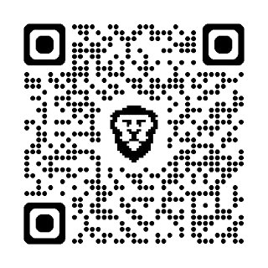
BGS COLLEGE OF ENGINEERING & TECHNOLOGY
BGSKH Education Trust (R.) - A Unit of Sri Adhichuchanagiri Shikshana Trust (R.)
Mahalakshmipuram, Bengaluru- 560086
(Approved by AICTE, New Delhi and Affiliated to VTU, Belagavi)
||ಯತ್ರ ಪ್ರಾಚೀನಂ ಭವತಿ ಆಧುನಿಕಂ||
Scan QR
3rd and 4th May 2025
Convenors
Dr. Madhura Gangaiah, Mrs.Shruthi K S
BGSCET
Dr. Ravikumar G K
Principal,BGSCET
Dr. G T Raju Director,BGSCET

Slide 2
SAMVIT – "Lord Vishnu endow us with good thoughts" encompasses the entire spectrum of knowledge, from information to consciousness, awareness and the highest knowledge leading to Self-realization. As BGSCET’s cultural fest it makes a mission to deliver and to give the attendees a sense of the BGSCET experience. The fest marks the beginning of BGSCET’s cultural ethos, to bring together students from various colleges to take part in the vibrant culture of BGSCET. We are on a mission to make everyone a part of SAMVIT and to provide something unique for all fellow attendees and savour the experience as a lifelong memory.

Slide 3
LIST OF EVENTS
DANCE
VOCALS
VISUAL ARTS
MEDIA
LITERARY
E-SPORTS
TECHNICAL
FASHION SHOW

Slide 4
DANCE
CLASSICAL SOLO DANCE
WESTERN SOLO DANCE
FOLK GROUP DANCE
WESTERN GROUP DANCE
PRIZE POOL UPTO
₹55000

Slide 5
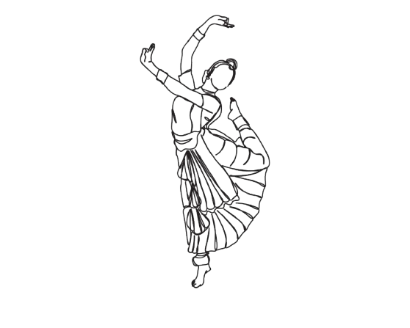
Classical Solo Dance
Tāṇḍav
Rules & Regulations:
Duration: 6 to 12 minutes
Max 2 accompanists
Setup time: Max 6 mins
Only classical dance forms are accepted.
Only Carnatic or Hindustani music allowed.
Strictly no film songs.
Submit 3 copies of the performance description with the mp3 audio by 1st May 2025 to the student coordinator.
Submit the same mp3 audio via pen drive at least 3 hours prior the event.
Student Coordinator : Chandana (9599329103)
Faculty Coordinator : Dr.Sangeetha (9538414113)

Slide 6
Western Dance Solo
Taalrang
Rules & Regulations:
Duration: 10 minutes total (6-7 minutes performance and 3 minutes for Stage Clearance)
Max 2 accompanists.
All Western dance styles are allowed.
Offensive gestures lead to disqualification.
Submit 3 copies of the performance description with the mp3 audio by 1st May 2025 to the student coordinator.
Submit the same mp3 audio via pen drive at least 3 hours prior the event.
Student Coordinator : Sushmitha (8884844804)
Faculty Coordinator : Dr.Ambika (9900503175)

Slide 7
Folk Group Dance
Janānṛtya
Rules & Regulations:
Duration: 12–13 minutes (including setup/clearance).
Max 3 accompanists.
Only Indian folk/tribal dances allowed.
No Bollywood or Western dance.
Submit 3 copies of the performance description with the mp3 audio by 1st May 2025 to the student coordinator.
Submit the same mp3 audio via pen drive at least 3 hours prior the event.
Student Coordinator : Apeksha (9902476066)
Faculty Coordinator : Mrs. Bhavyashree (7411684198)
Mrs. Manasa(9880004635)

Slide 8
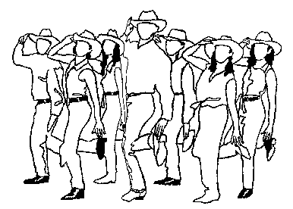
Western Group Dance
Nrityadhara
Rules & Regulations:
Each team: Up to 10 participants
Duration: 12–13 minutes (4 minutes for setup /clearance)
Max 3 accompanists
Western forms allowed: Hip-hop, Jazz, Contemporary, etc.
Submit 3 copies of the performance description with the mp3 audio by 1st May 2025 to the student coordinator.
Submit the same mp3 audio via pen drive at least 3 hours prior the event.
Faculty Coordinator : Mrs. Jyothi (9686460322) Mrs.Sanjitha(8660549805)
Student Coordinator : Dhanul (9538254959)

Slide 9
VOCALS
CLASSICAL SINGING SOLO
WESTERN SINGING SOLO
BATTLE OF BANDS
PRIZE POOL UPTO
₹30000

Slide 10
Classical Singing Solo
Swaraanubhava
Rules & Regulations:
Only Carnatic solo vocal performances allowed.
No semi-classical, film-based, or light music.
Max 2 accompanists (e.g., Mridangam, Violin, Tambura);
Electronic tanpura allowed.
No group singing.
Competition Rounds:
Swara Pravesha (Introductory) – 2 mins
Bhaava Raaga (Thematic) – 4–5 mins
Raga Prayoga (Challenge) – 5–6 mins
Student Coordinator : Rachana(8317369864)
Faculty Coordinator : Dr.Channakeshava Naik(8123213250)

Slide 11
Western Solo Singing
Surmaya
Rules & Regulations:
Languages – English/Kannada/Hindi
Instruments of any kind (digital/live) karaoke and programmed music are strictly not allowed.
Backing tracks must be strictly instrumental only (no vocal guide/lyrics)
Medleys or mashups are allowed as long as they maintain a coherent flow.
Student Coordinator : Chavi (7892220983)
Faculty Coordinator : Mrs.Asha (8660121214)

Slide 12
Battle of Bands
Svara Rañjana
Rules & Regulations:
A team should have a minimum of 3 and maximum of 10 members.
Each group will be given a total of 8 minutes to perform, maximum of 5 minutes will be given for setting up instruments and clearance .
Bring your own musical gear, instruments of all kinds are welcomed.
The techrider should be submitted after registration, songs from every region and genre are welcome. Individual creativity is also valued.
Use of profanity , hate speech or offensive content will result in immediate disqualification. No pre recorded tracks or MIDI controllers are allowed.
Student Coordinator : Lakshman (9449780327)
Faculty Coordinator :
Mr. Kiran( 9632538944)

Slide 13
VISUAL ARTS
ON SPOT PAINTING
FACE PAINTING
ON SPOT PHOTOGRAPHY
PRIZE POOL UPTO
₹15000

Slide 14
On Spot Painting
Sahasika Chitranka
Rules & Regulations:
Only one standard A2 size paper will be provided by the institution.
Allowed mediums: watercolors, poster colors, oil paints, acrylics and pastel colors.
Participants must bring their own materials such as brushes, paints, palettes etc.
Theme will be announced on the spot.
Duration: 2 hours.
Art must be appropriate for public viewing.
Student Coordinator : Kiran Kumar (9380205774)
Faculty Coordinator : Ms. Maheshwari (9482201653)

Slide 15
Face Painting
Mukha Chitranka
Rules & Regulations:
Duration: 90 minutes.
Artwork to be done on the spot.
Theme: Earth and Beyond (nature, planets, galaxies, cosmic creatures, etc.)
Bring your own skin-safe paints, brushes, tools.
No tool sharing allowed.
Can paint on own face or a model (1 model per participant).
No offensive designs
Student Coordinator : Keerthana ML (8867042580)
Faculty Coordinator : Ms. Maheshwari(9482201653)

Slide 16
On Spot Photography
Kṣhaṇa Kathā
Rules & Regulations:
Duration: 4 hours.
Participant must bring a digital camera and memory card (to be formatted by judges in prior).
No mobile phones, drones, or alternate devices.
Capture 5 photos based on on-spot theme.
Any kind of editing/morphing or image manipulation software is not allowed.
Photos must be taken within defined area.
Organizers hold rights to use the photos.
Additional instructions will be given on spot.
Student Coordinator : Balaji (9019038818)
Faculty Coordinator : Dr.Neetha (9650024121)

Slide 17
MEDIA
PRIZE POOL UPTO
₹20000
STREET ACT PLAY

Slide 18
Street Act Play
Rathyā Pradarśanam
Rules & Regulations:
Team size: 6–9 members (+3 accompanists).
Duration: 10–15 mins performance + 5 mins setup/clearance.
Languages: Kannada, Hindi, or English.
Submit 3 copies of the performance description with the mp3 audio by 1st May 2025 to the student coordinator.
Submit the same mp3 audio via pen drive at least 3 hours prior the event.
Student Coordinator : Sohan.M (9663891355)
Faculty Coordinator : Mrs.Manjula M(9886254365)
Mr. Naveen(8861242494)

Slide 19
LITERARY
PRIZE POOL UPTO
JAM
DEBATE
₹20000

Slide 20
JAM(Just A Minute)
Kshanika Vagvilasa
Rules & Regulations:
Topic will be given randomly (either picked or assigned).
Prep time: 10–30 seconds.
Speak for exactly 1 minute with no hesitation, repetition, grammatical errors or deviation.
Language must be clear and non-offensive.
Creativity, personal stories, humor encouraged if relevant.
Good body language and voice modulation required.
Student Coordinator : Arya Prashanth (8779075821)
Faculty Coordinator : Mrs. Manjula Raghu (8867234664)

Slide 21
Debate
Vada - Vivada
Rules & Regulations:
5 minutes per speaker (10 minutes per team).
The competition will be held in two rounds.
The final round will follow British Parliamentary debate format.
The topics for both rounds will be given on spot or before an hour with appropriate preparation time.
English and Kannada shall be the medium of presentation.
Teams will be restructured among the speakers.
Reading from a sheet is not permitted.
Student Coordinator : Chethana(9740810574)
Faculty Coordinator : Dr.Nithin(9844546475)

Slide 22
E-SPORTS
PRIZE POOL UPTO
BGMI
FREE FIRE
₹20000

Slide 23
Esports Tournament
BGMI & Free Fire
Rules & Regulations:
Game title and format will be announced prior to the event.
Registration with correct in-game ID required.
Platform: PC/Console/Mobile as per game
Cheating or hacking is strictly prohibited.
No verbal abuse or toxic behavior.
Random drop zones.
Matches will be re-hosted only in case of server issues.
Scoring:
1st = 15 points, 2nd = 12 points, 3rd = 10 points, 4th = 8 points, 5th = 5 points
1 point per kill.
No third-party apps or hacks.
BGMI
Student Coordinator : Roshan(9591294043)
Faculty Coordinator :Mr. Satisha G (9141870304)
Free Fire
Student Coordinator : Anush(8217728475)
Faculty Coordinator :Mr. Chetan H V (7795788309)

Slide 24
TECHNICAL
TECH QUIZ
CYBER ETYMOLOGY
CSS BATTLE
PRIZE POOL UPTO
₹25000

Slide 25
Tech Quiz
Rules & Regulations
There must be 3 members per team.
No phones, no gadgets and absolutely no shortcuts!
Questions will be related to technology.
General quiz rules applied.
The time limit is set and there's no room for extensions.
Student Coordinator : Aaditya Srinivasan (9880284141)
Faculty Coordinator : Ms. Poojitha (9945556062)

Slide 26
CSS BATTLE
Rules & Regulations:
Solo entries only.
You will have 30 minutes to recreate web graphics.
There will be 2 rounds.
It will be judged based on how fast and how many lines of code is used to recreate it.
The faster or lesser the lines of code the more points you'll gain.
Replicate the given design only using HTML and CSS.
Student Coordinator : Manoja(9902798895)
Faculty Coordinator : Mr.Anoop Prasad N (9742599168)

Slide 27
Cyber Etymology
Rules & Regulations:
There should be 2 members in a team.
Every team will be given an alphabet, you will have to form a technical term and which team produces a word with the longest length they will be awarded more points.
Student Coordinator : Vilas C P(7892466923)
Faculty Coordinator : Mr. Manjunath (8861991408)

Slide 28
Treasure Hunt
Rules & Regulations:
Each team must have a minimum of 3 and a maximum of 4 members.
Embark on a thrilling journey through 8 rounds of mindbending challenges. Follow the technical clues provided to uncover the path to your ultimate destination and claim victory!
Student Coordinator : Keerthan (7760807120)
Faculty Coordinator : Mr.Anoop Prasad N (9742599168)
PRIZE POOL UPTO
10000

Slide 29
Fashion Show
Vastrabhivyakti
Rules & Regulations:
Team Size: 8-15
Inappropriate or offensive clothing is not permitted.
Open to all themes.
Props must be pre-approved.
Submit 3 copies of the performance description with the mp3 audio by 1st May 2025 to the student coordinator.
Submit the same mp3 audio via pen drive at least 3 hours prior the event
Student Coordinator : Devika(9483471679)
Faculty Coordinator :
Ms.Sindhu (8095181543)
Mrs. Sushma(8618857599)
PRIZE POOL UPTO
25000

Slide 30
General Instructions:
SAMVIT the techno-cultural fest of BGSCET is scheduled to take place on May 3rd and May 4th, 2025.
Teams must get their own musical instruments and any other necessary materials required for the performance.
The use of tobacco, alcohol or any narcotic substances by participants, accompanists or team managers will result in immediate disqualification.
All contingent members are expected to uphold discipline and maintain decorum within and outside the college premises. Any misconduct will result in strict disciplinary actions.
All contingents are expected to come in decent attires to the fest. Failing which strict disciplinary actions will be taken.
All the participants must report to the respective event venues 30 minutes prior to their performance.
The decisions made by the judging panel will be final and cannot be contested.

Slide 31
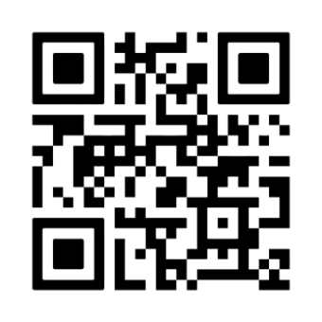
The organizers reserve the rights to alter the schedule of the event at any point of time.
All participants must carry their institutional identity cards.
The use of flammable items or props resembling flammable materials is strictly prohibited.
All participants are required to bring their own props, and they must ensure that the props comply with safety regulations.
Teams must set up as well as clean up their own props and set after the performance.
Submit 3 copies of the performance description with the mp3 audio(if applicable) by 1st May 2025 to the student coordinator.
Submit the same mp3 audio via pen drive at least 3 hours prior the event.
Scan QR for registration

Slide 32
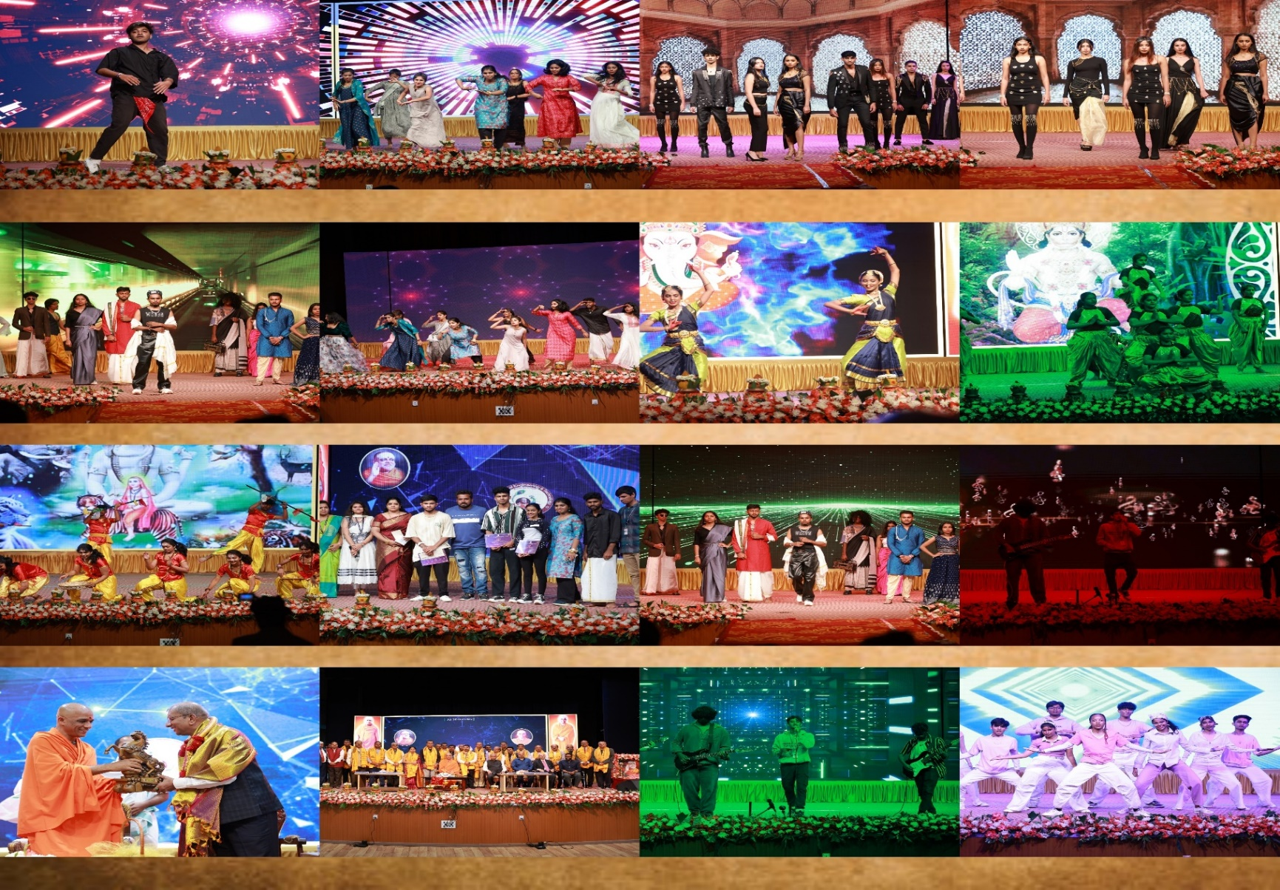
GLIMPSES OF
SAMVIT 2K23

